Slide 1

Ansox Industries Pvt Ltd

Slide 2

The journey to date
2017 July Ansox Incorporated by Shashikant Jadhav
2017 August Started operations by manufacturing Sheet Metals Components, Plastic Injection Molding & blow Molding Components
2017 September Receieved TS 16949 Certification
2018 May Added Aluminum Stamping Line for TTR
2018 December Tool Shop Started to Focus on New Product Development
2019 March Acquired 1 Acre Plot with Shed for relocation in Chakan Pune.
2019 November Relocated Plant in Chakan Pune
2020 October Added 2 Blow Molding Machines and Started Manufacturing Lines for Air Intake System for commercial Vehicles.
2021 February IATF 16949 Certification
2021 March Set up Manufacturing Line for T Bolts & Worm Clamps
2021 December Acquired adjoining 1 acre plot for expansion
2022 January Set up Manufacturing Line for Rolling Pipe Fabrication

Slide 3

The journey Ahead….
New Projects on Hand:
DuroShox – Business awarded for Blow Molded Parts. SOP started
CommScope – Business Awarded. SOP started
Mahler Filter – Business Awarded.
Siemens – Business Awarded. SOP Feb 2023
Parker – Under Discussion
Piaggio India – 2 wheeler

Slide 4

Ansox - Team
Shashikant Jadhav
CEO
Dayasagar Mrig
CEO
Ajit Singh
Plant Head
Santosh Bhoite
HR
Mahesh Kolte
CAM
Rajesh Argekar
NPD & Tool Room
Akshay Shinde Quality Head
Material & Store – Sardar Patil
Press Shop – Nazir Pathan
Molding shop – Pratik Kadam

Slide 5














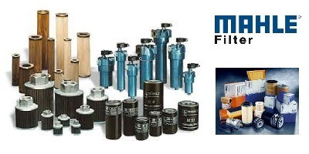


OUR CUSTOMER BASE

Slide 6

 |  |  |  | CEO
 |  |  |  | Mr. SHASHIKANT JADHAV |  |  | Ansox - Team
 |  |  |  | PLANT HEAD
 |  |  |  | Mr. AJIT SINGH
DESIGN AND DEVELOPMENT, NPD HEAD |  | PRODUCTION HEAD |  | HR / ADMINISTRATION HEAD |  | MATERIAL & STORE HEAD |  | QUALITY HEAD |  | MARKETING AND SALES HEAD
MR.RAJESH ARGEKAR |  | Mr. SHASHIKANT JADHAV |  | Mr. SANTOSH BHOITE |  | Mr. SARDAR PATIL |  | Mr. AKSHAYKUMAR SHINDE |  | Mr. MAHESH KOLTE
 |  | INJECTION / BLOW MOULDING SUPERVISOR
PROCESS ENGINEER (APQP/PPAP) |  | Mr. PRATIK KADAM |  | ASSISTANT |  | PURCHASE HEAD |  | QA ENGINEER
NIJGUNI B |  |  |  | Mr. YOGESH CHAVAN |  | Mr. PRAFULL PATIL |  | Mr.SUDHIR BANDGAR
TOOL ASSEMBLY |  | INJECTION MOULDING EXECUTIVE |  | INJECTION OPERATORS |  | SUPERVISOR |  | SUPPLIER QUALITY
P KOLI |  | Mr. SACHIN THITE / Mr. SAKHARAM JADHAV/SAI PATIL |  | 12 (CONTRACT BASE) |  | 3 (CONTRACT BASE) |  | Mr. UJJVAL INGALE
TOOL ASSEMBLY |  | BLOW MOULDING SUPERVISOR |  | BLOW MOULDING OPERATORS |  | HELPER |  | QA ENGINEERS
UDAY PATIL |  | Mr. GOPAL INGOLE |  | 6 (CONTRACT BASE) |  | 2 (CONTRACT BASE) |  | 5 (CONTRACT BASE)
TOOL AND DIE MAKER |  | PRESS SHOP EXECUTIVE |  | PRESS MACHINE SETTERS
CONTRACT BASE |  | Mr. NAZEER PATHAN |  | Mr. Ashoke Shirke Mr. Prakash Chavan Mr. Shivkumar Kharule Mr. Bhikan Mahale Mr. Devrav Pande
TOOL ASSEMBLY
SUDHIR KALAMBATE
VMC PROGRAMMER
Mr. SACHINE KALAL

Slide 7
Ansox : Business Units
Stampings:
  Air Cleaner Caps
  Pre-Cleaner Housing
  Shells : KB / Sotras
  End caps for filters
  Header Plates and Core Support
Plastic Injection Molding:
  Pre-Cleaners, Visi Bowls,
  Centre Tubes
Plastic Blow Molding:
  Pipes, Rain Hood ,
  Duct ,
Tool Room:
  Press Tools, Moulds for Rubber and Plastic ,
  Test Rigs, Jigs & Fixtures, SPMs

Slide 8
Ansox Industries Pvt Ltd Quality & Environment Management System – Road Map
IATF 16949 Certified
VDA 6.3 (Process Audit) Passed for MIBA Drive tech , Siemens , Mahle thermal and Mahle Filter
ISO 14000
Awareness Training for all Employees
Start Implementation
Certification - March 2023

Slide 9
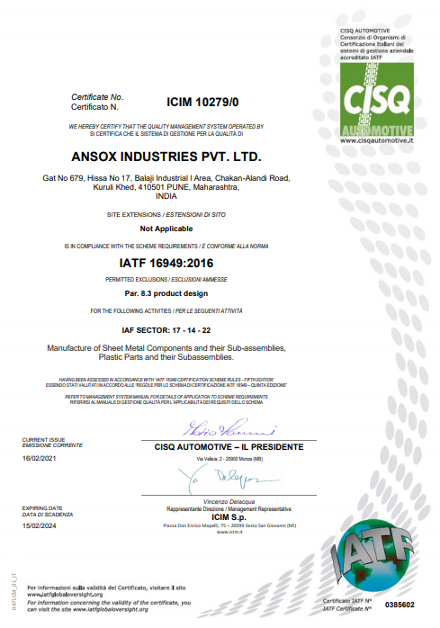
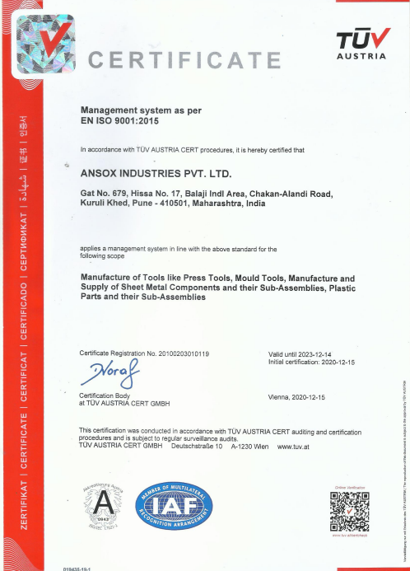
Ansox : Quality Management System Certification IATF- 16949; Certification ISO 9001:2015

Slide 10
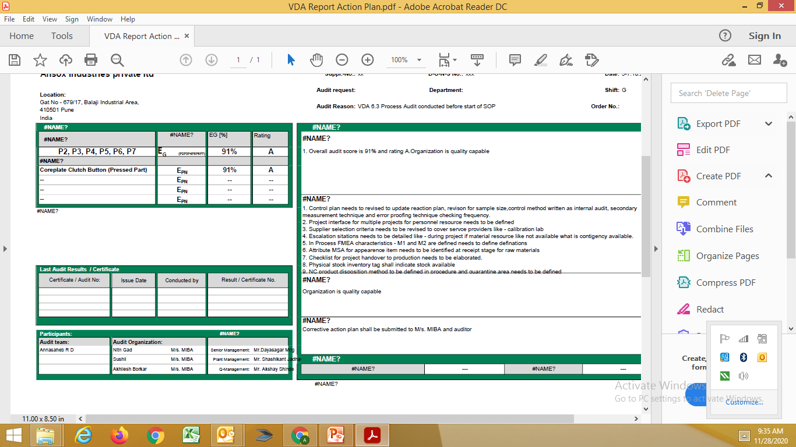
Ansox Industries Pvt Ltd Quality & Environment Management System – Road Map
VDA 6.3 (Process Audit) Passed for Mahle Thermal and Mahle Filter
VDA 6.3 (Process audit) Passed for MIBA DRIVETECH INDIA PVT LTD by external body.
ISO 14000
Awareness Training for all Employees
Start Implementation at new location.

Slide 11
Ansox Industries Pvt Ltd
Our Valued CUSTOMERS (Automotive):
Fleetguard Filters Pvt. Ltd. (Joint Venture with Cummins India) (Daimler, Tata Motors, Knorr Bremse, Ashok Leyland)
Mahle Behr
(VW, Suzuki, Nissan, JCB, Fiat, Tata Motors, Mahindra)
MIBA
Tata Toyo Radiator
(Tata Motors, Renault, Isuzu, Volvo)
Divgi Torque Transmission System
(Borg Warner)

Slide 12
Ansox Industries Pvt Ltd
Our Valued CUSTOMERS (Non-Automotive):
Hawkins - (Pressure Cooker)
Tata BlueScope – (Construction Industry for India & Blue scope worldwide)
ULTRA Engineers – (Solar Panels for Arya Electricals USA)
Robertshow – (Thermostat Side Support)
CommScope- communication antina aluminum frame and support
Siemens – Terminal Box for electric motors

Slide 13
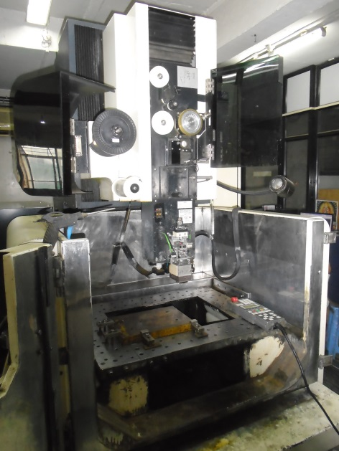
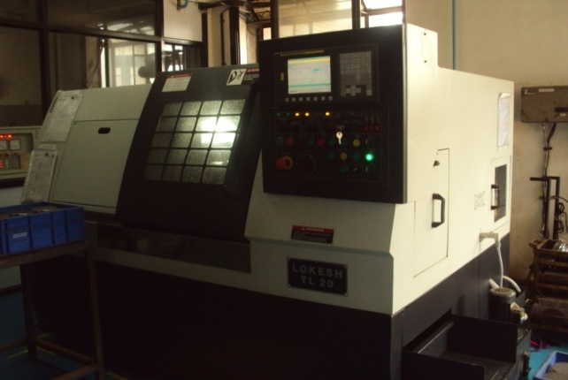
Capabilities - Tool Shop
Name of Machine | Nos | Make | Specification(mm)
VMC Milling M/c | 1 | Makino S33 | 650*450*450
VMC Milling M/C | 1 | AWEA | 1100*650*500
CNC Wire Cutting M/c | 1 | Makino SP43 | 450*300*300
CNC EDM M/c | 1 | Chmer | 300*200*200

Slide 14

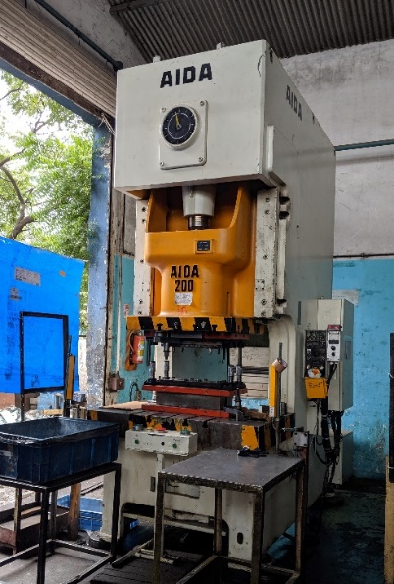
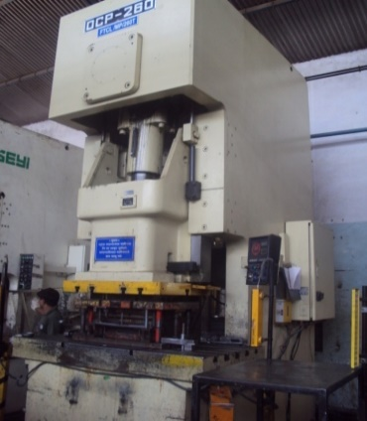
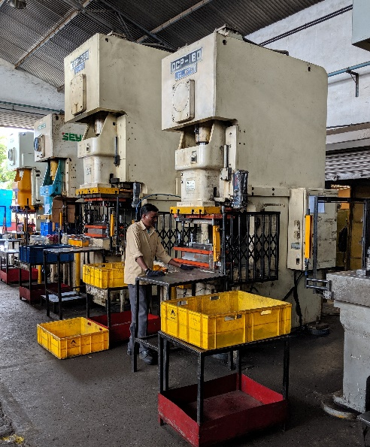
Capabilities – Press Shop
Capacity of Machine | Nos | Make
260 T Mech | 1 | Chin Fong
250 T Mech | 1 | Chin Fong
200 T Mech | 1 | SNC
200 T Mech | 1 | AIDA
175 T Hyd. | 2 | Fluid Power
160 T Mech | 1 | OCP
125 T Mech | 1 | Ameteep
110 T Mech | 1 | Komatsu
80 T Mech | 1 | OCP
63 T Mech | 4 | Master
40 T Mech | 1 | Master
32 T Mech | 4 | Master
25 T Mech | 2 | Master
100 T Hyd | 2 | Fluid Control
40 T Hyd | 2 | Fluid Control

Slide 15
Capabilities – Plastic Injection & Blow Moulding
Capacity of Machine | Nos | Make
420T | 1 | Haurang
300T | 1 | Jon Wai
220T | 1 | Jon Wai
150T | 1 | Jon Wai
100T | 1 | Jon Wai
800 T -1300 T | 1 each | Ferromatic at our Vendor
10 Lit | 1 | Blow Molding Mc
30 Lit | 1 | Blow Molding Mc

Slide 16
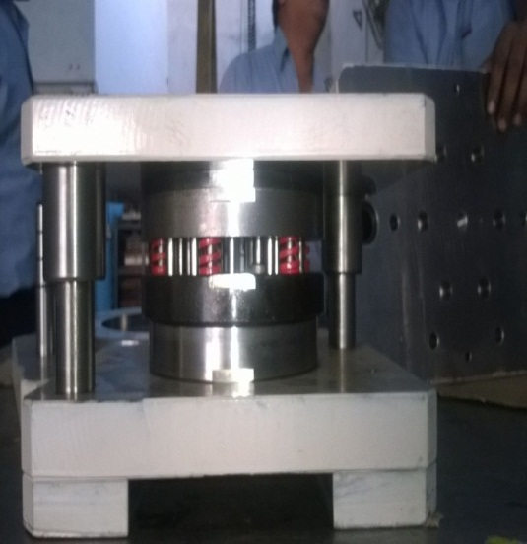
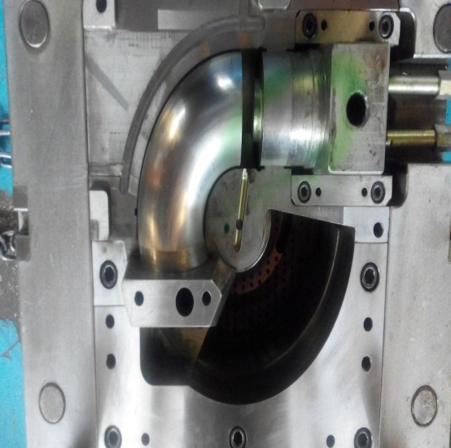
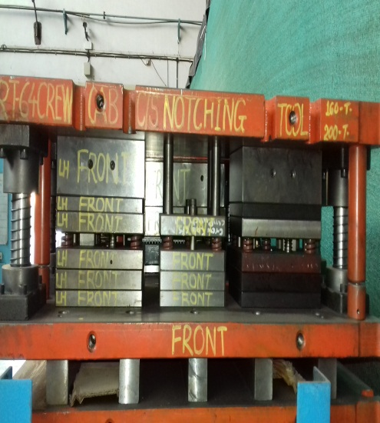
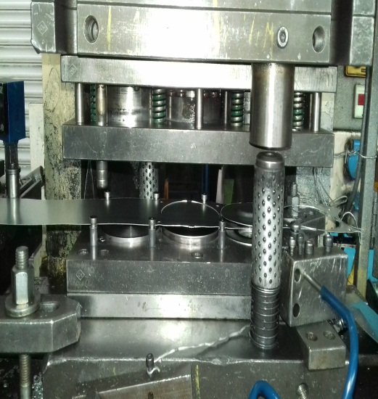
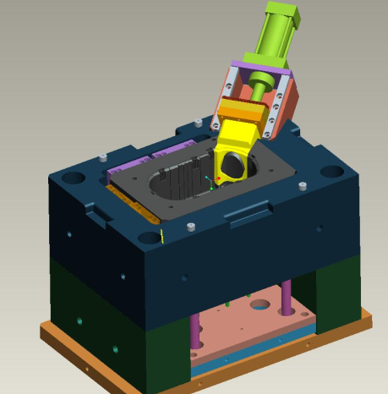
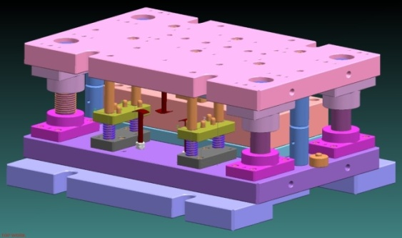
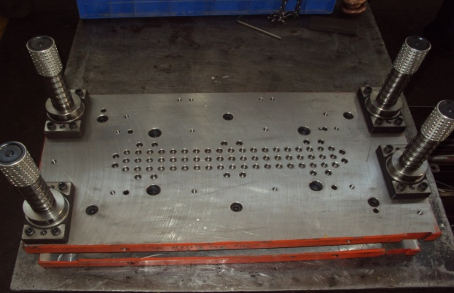
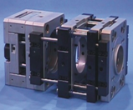
Press Tools, Dies, Moulds for Plastic & Rubber Parts

Slide 17
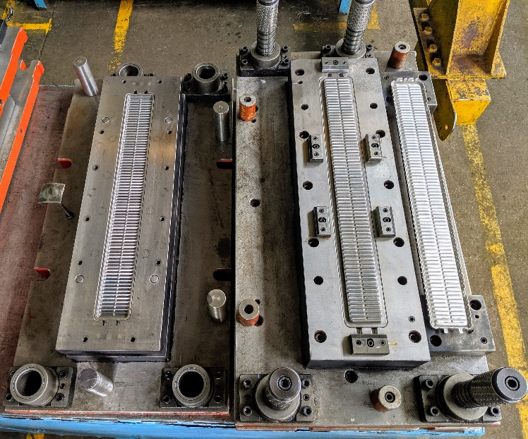
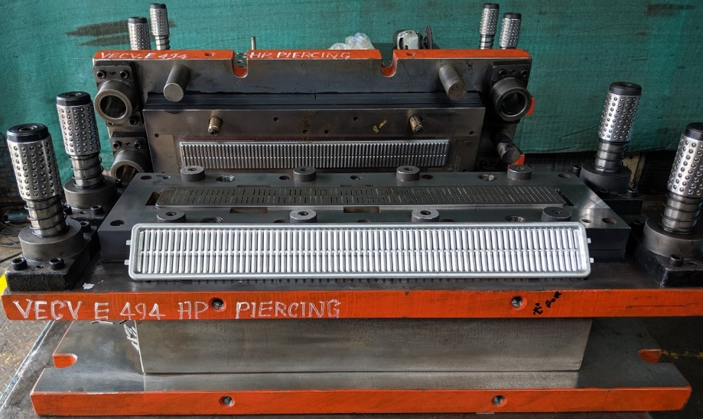
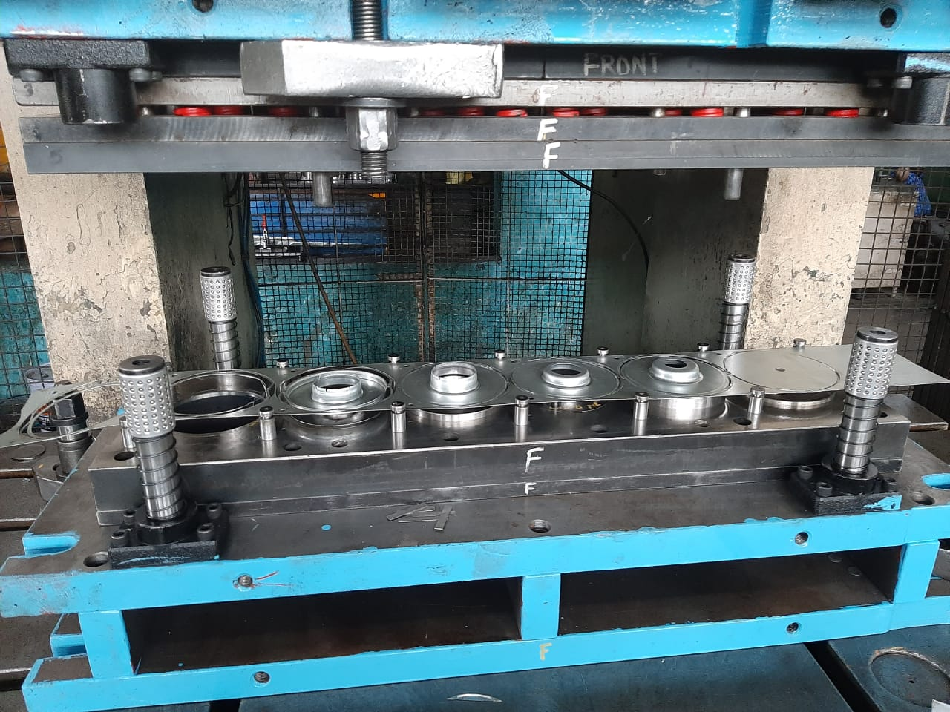
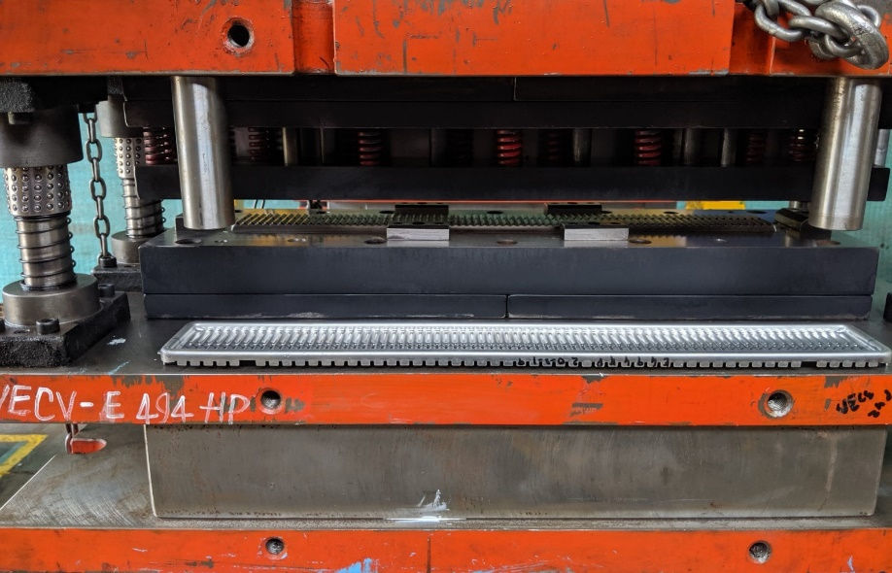
Press Tools

Slide 18
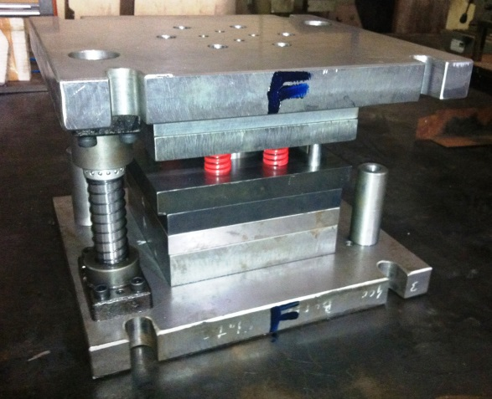
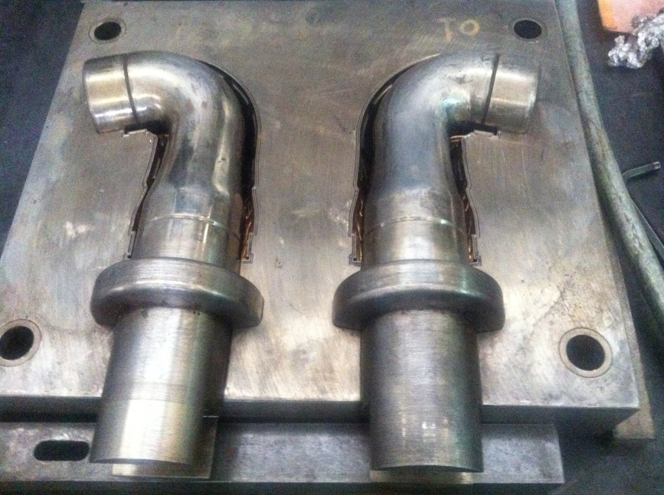
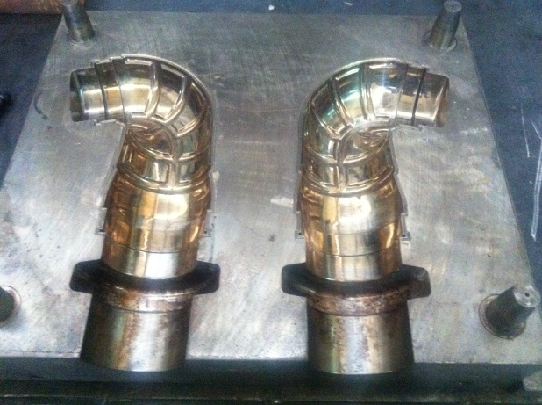
Toolings - Moulds

Slide 19
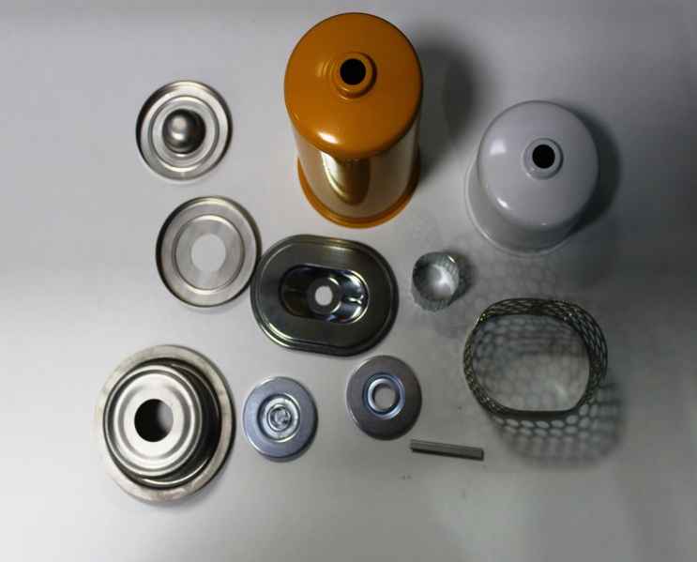
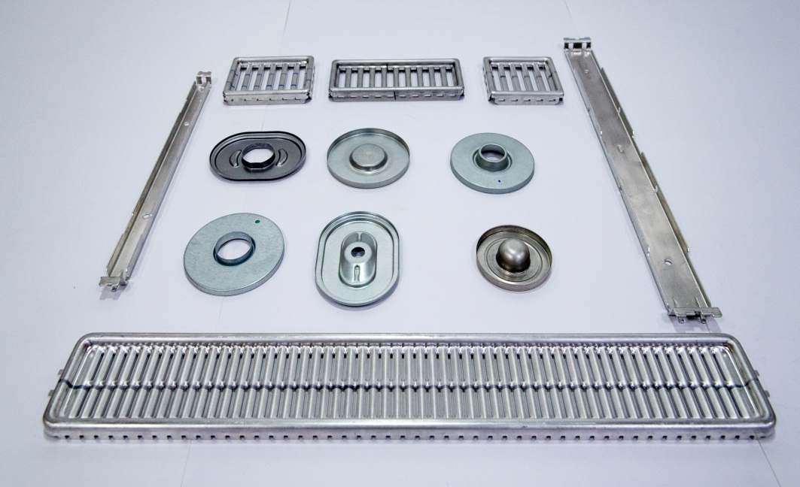
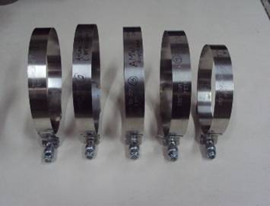
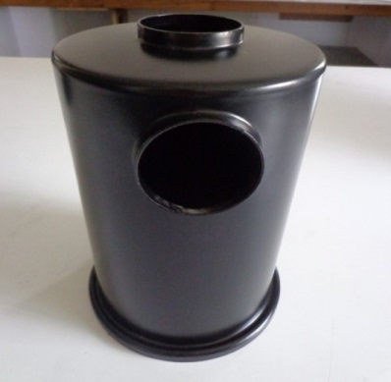
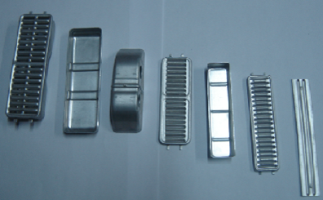
Stamping Parts Developed for Customers

Slide 20
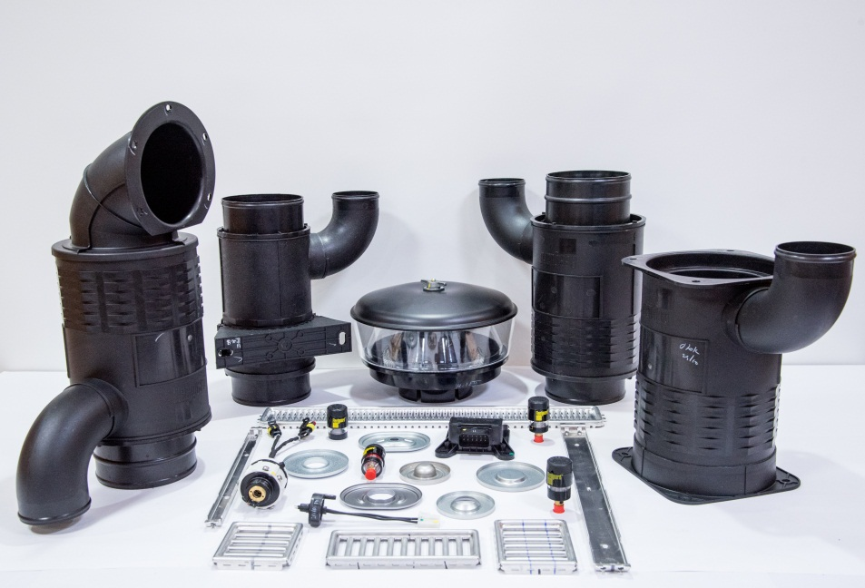
Injection Moulded Plastic Parts Developed for Customers

Slide 21
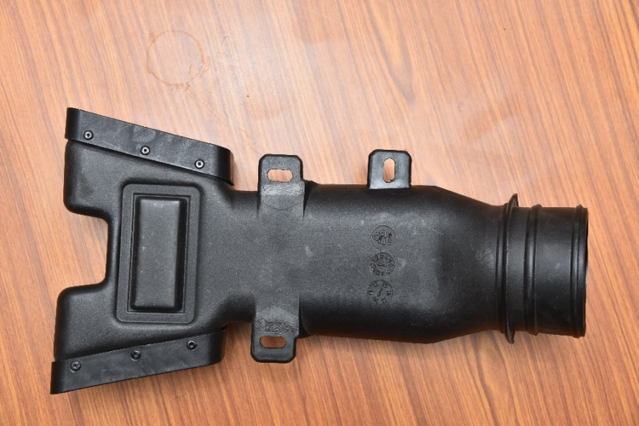
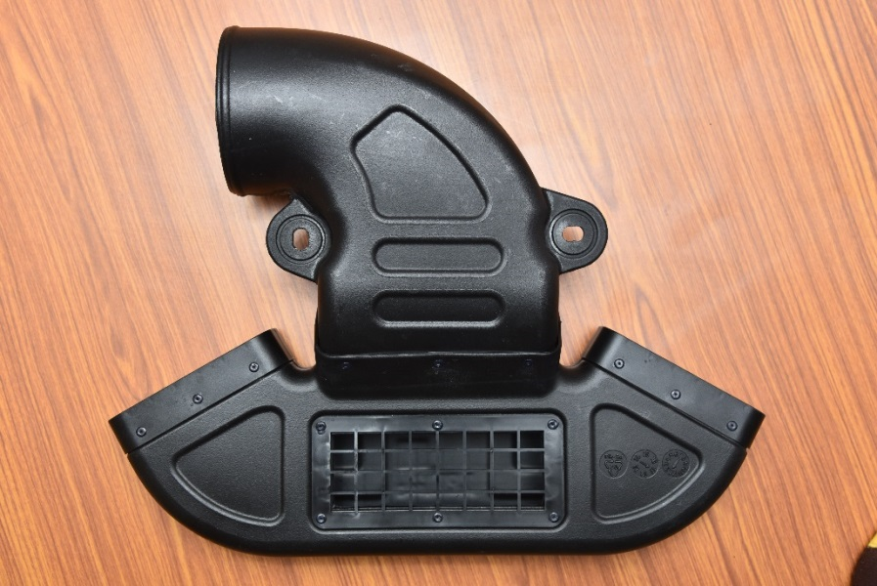
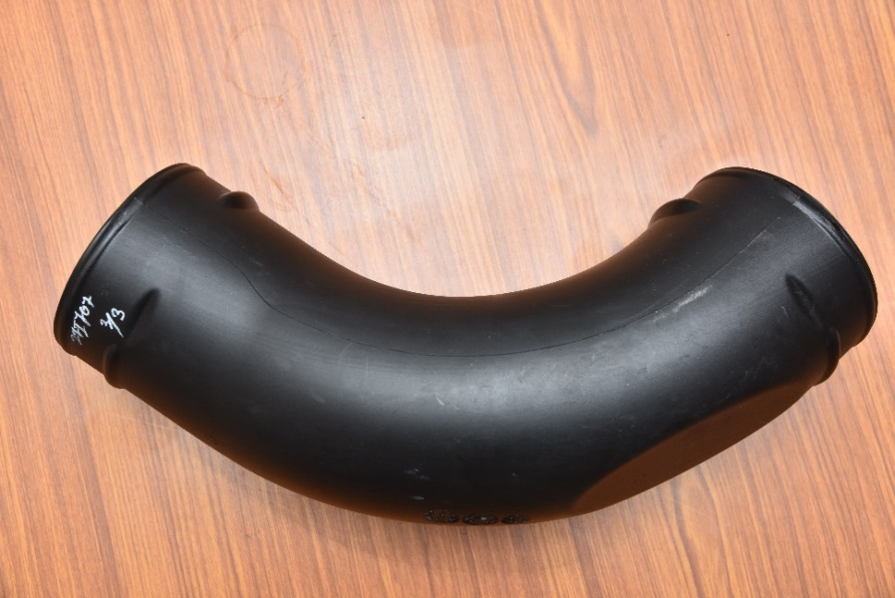
Blow Moulded Plastic Parts Developed for Customers

Slide 22
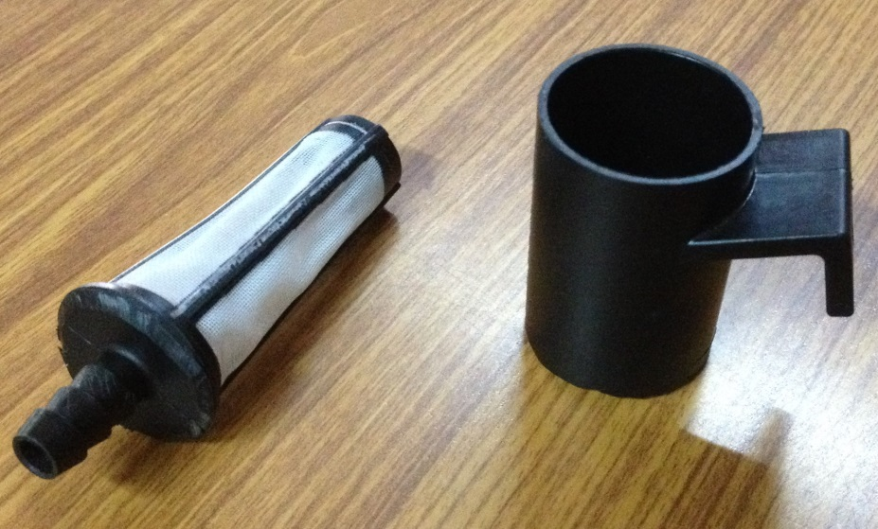
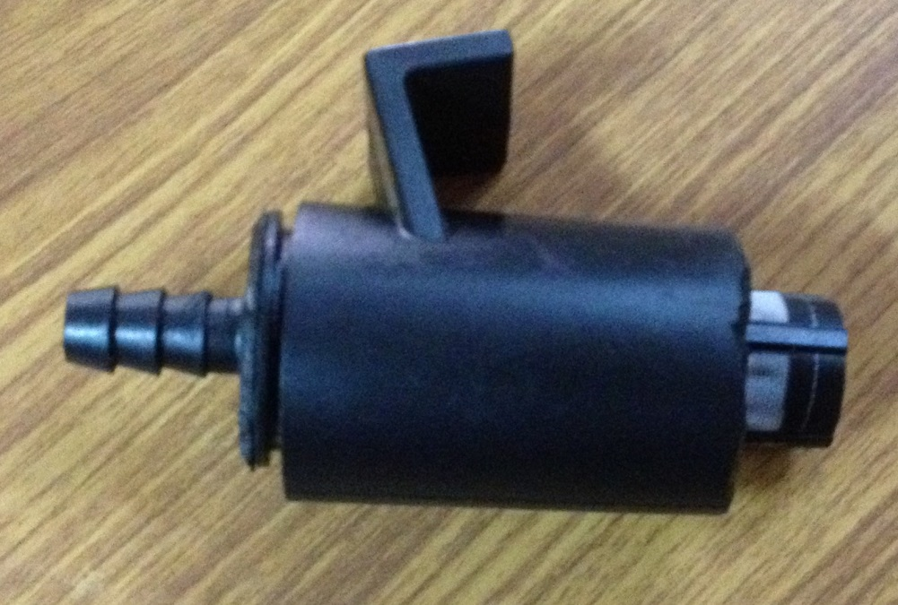
Strainer- Oil Filter

Slide 23
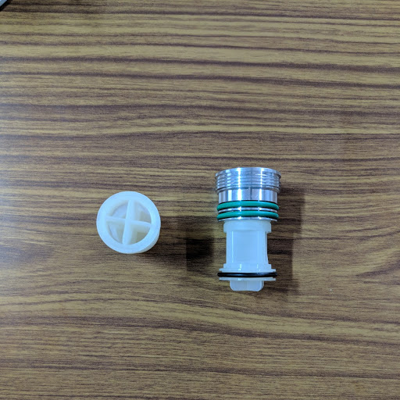
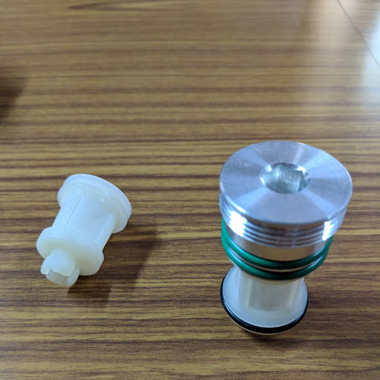
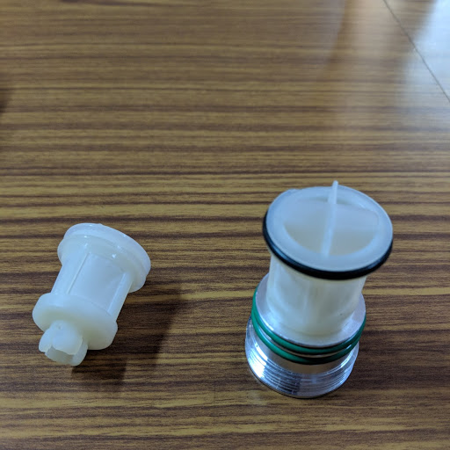
Filter Assembly for Tata Toyo

Slide 24
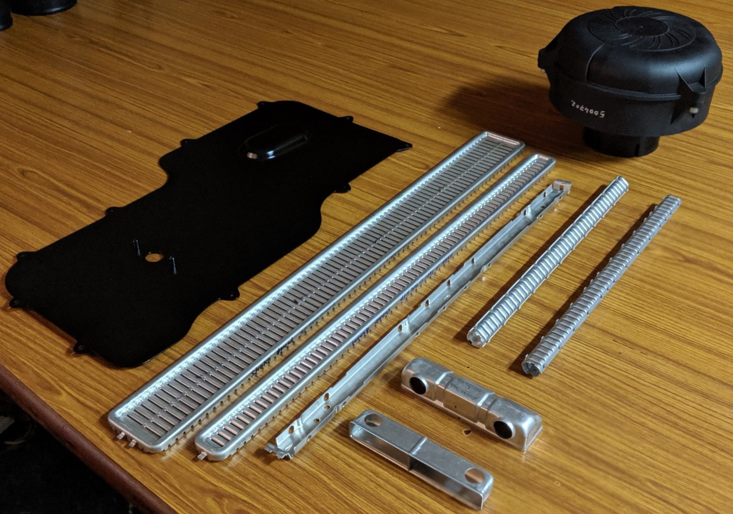
Tata Motors: Electric Car Battery Cooling Plate, Ejective Pre-cleaner,
Header Plates, Core Support, Condenser Assembly, Tank

Slide 25
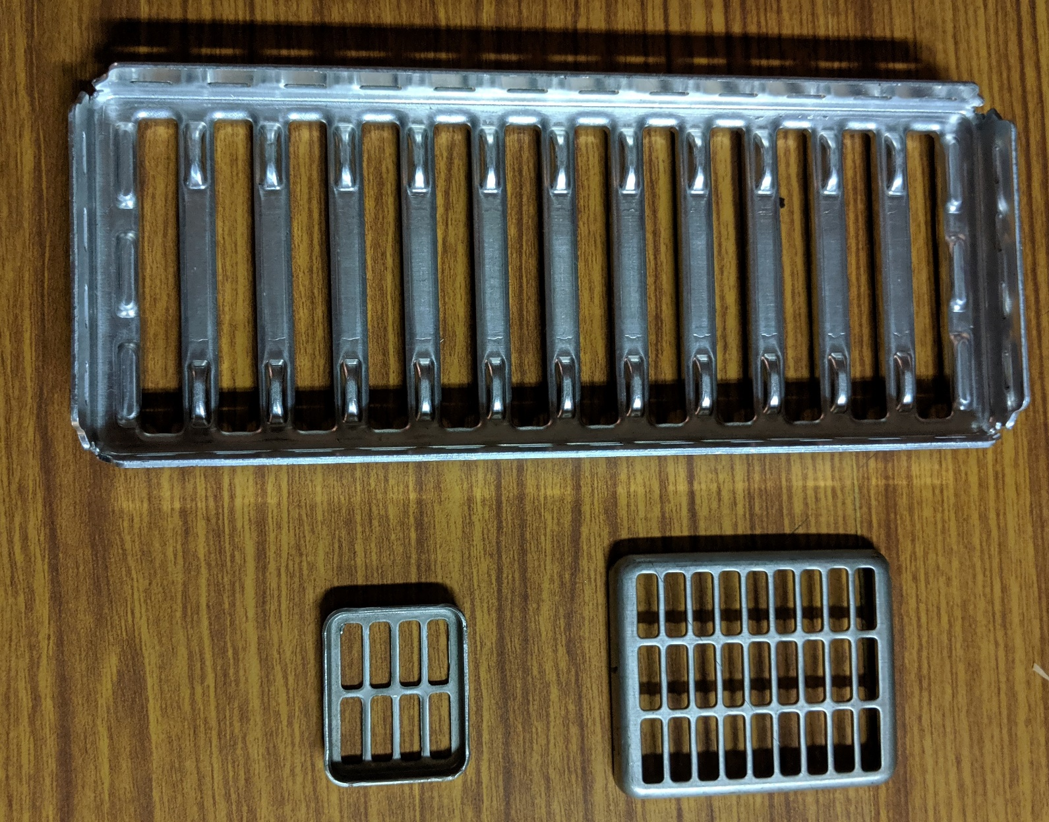
Maruti Suzuki: Header Plate, EGR Header Plates

Slide 26
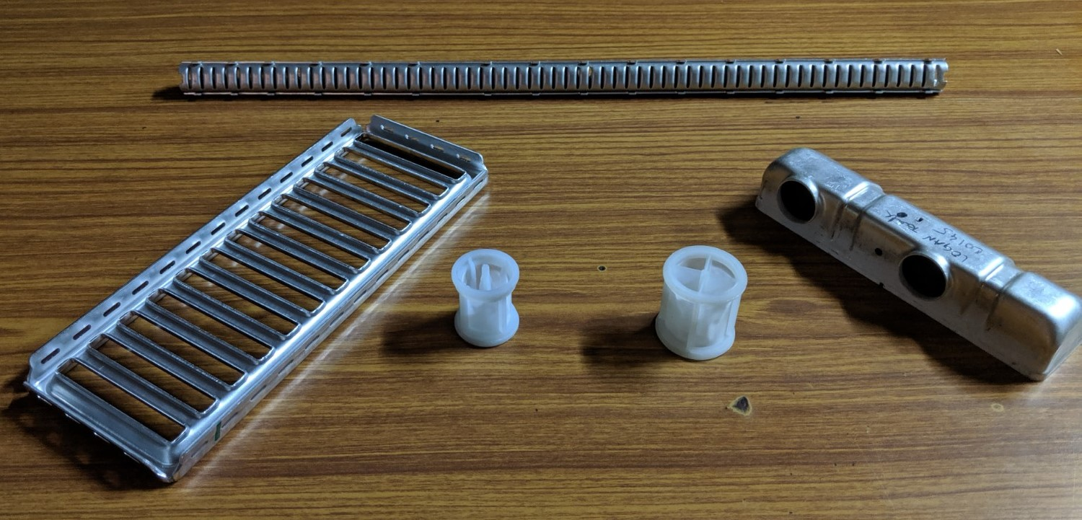
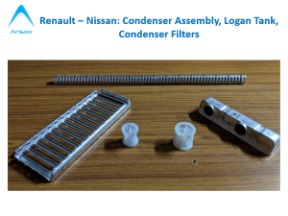
Renault – Nissan: Condenser Assembly, Logan Tank, Condenser Filters

Slide 27
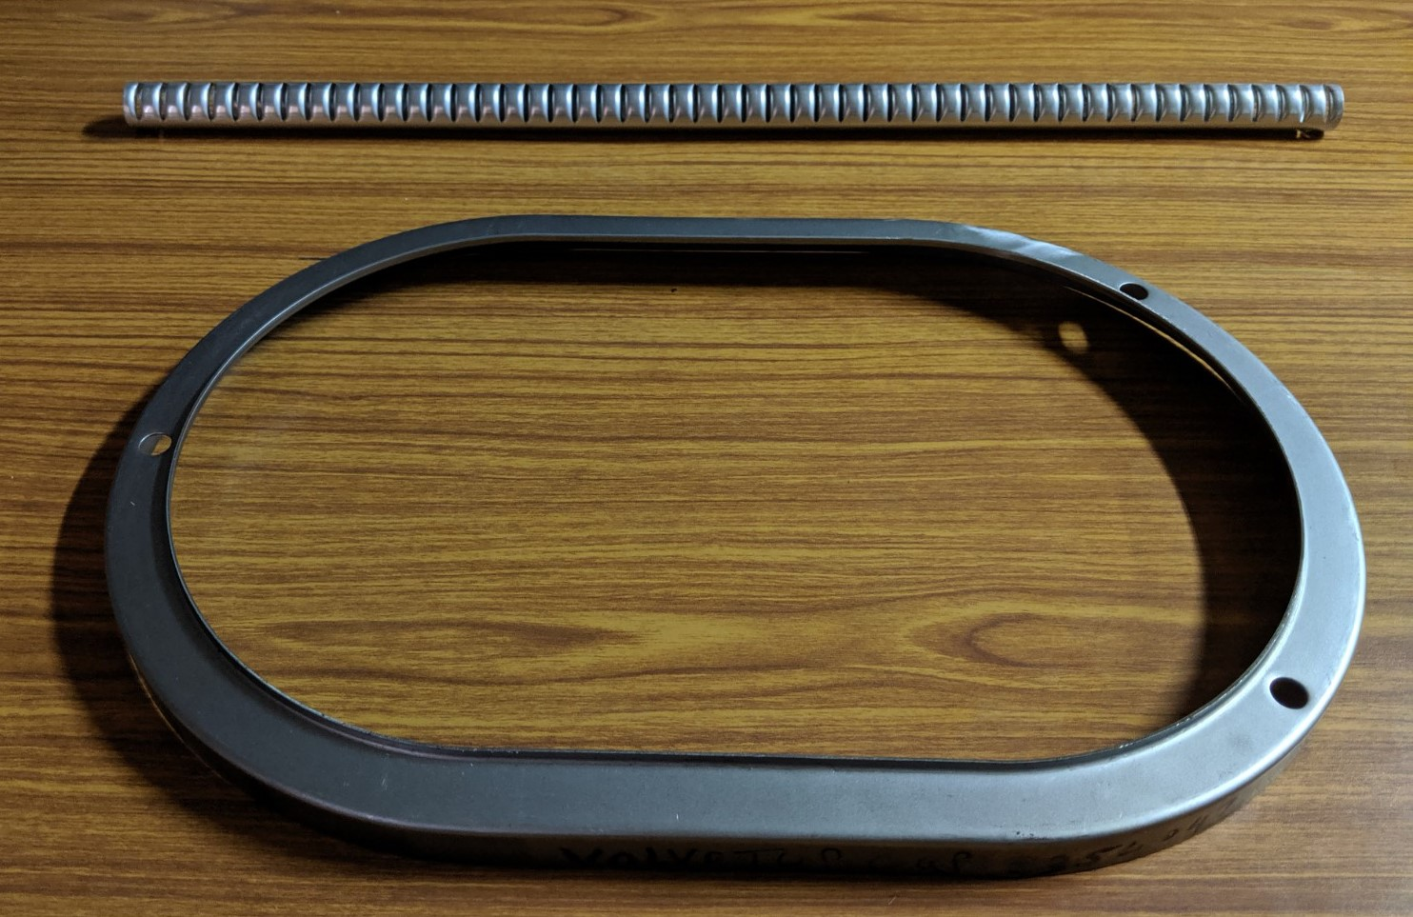
Volvo: Condenser Tube, Cover Top Metal

Slide 28
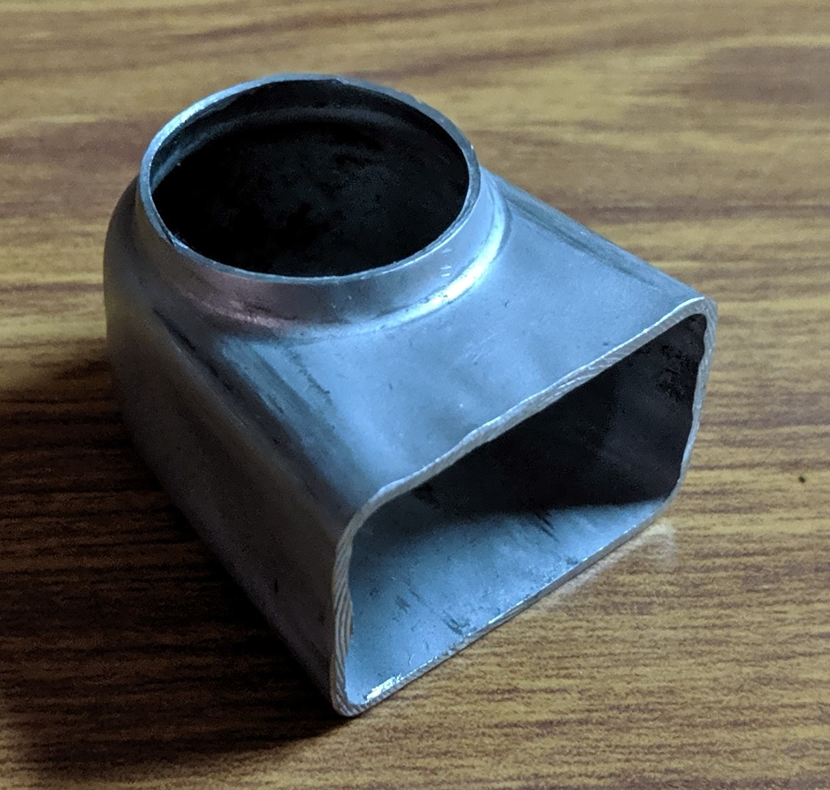
Fiat: Diffuser

Slide 29
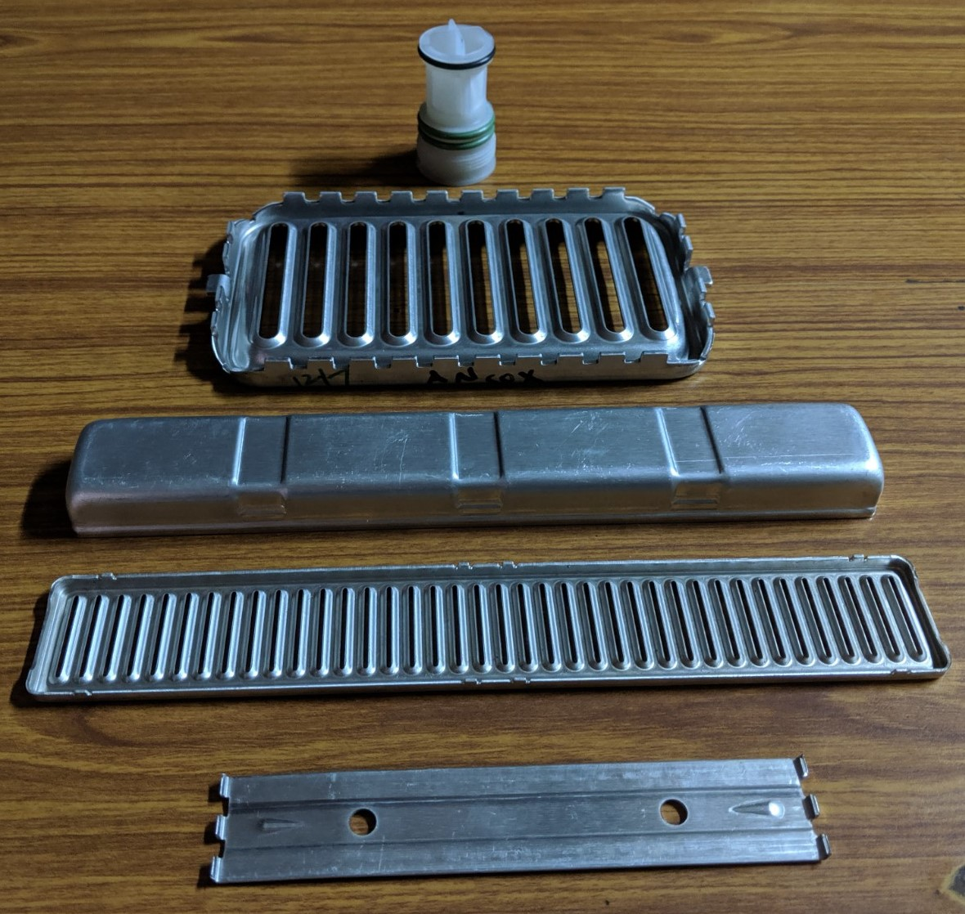
Isuzu: Condenser Filter, Header Plate, Heater Core Tank, Header Plate & Core Support

Slide 30
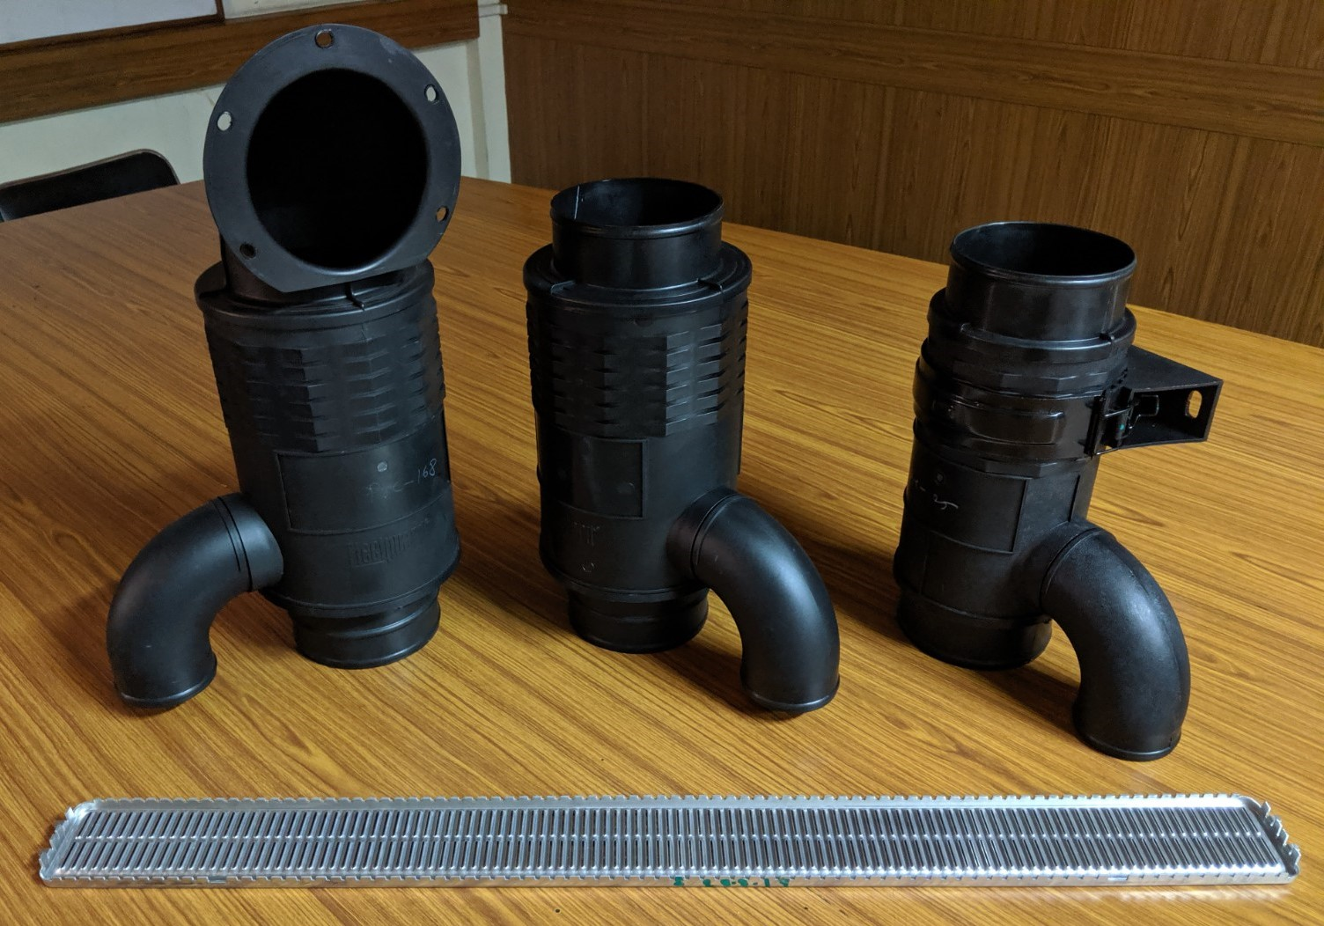
Ashok Leyland: Pre-Cleaner Air Filter Housings, Header Plate

Slide 31
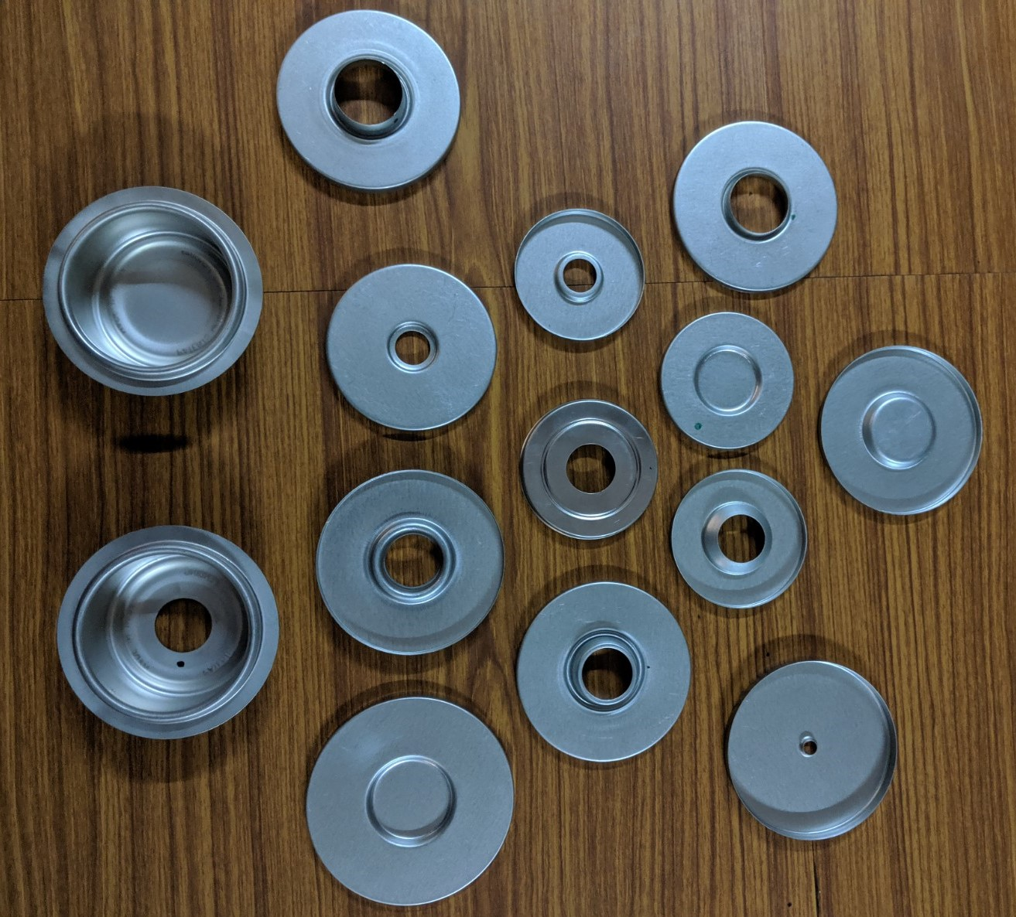
End Caps for Filters (3 Million/Month)

Slide 32
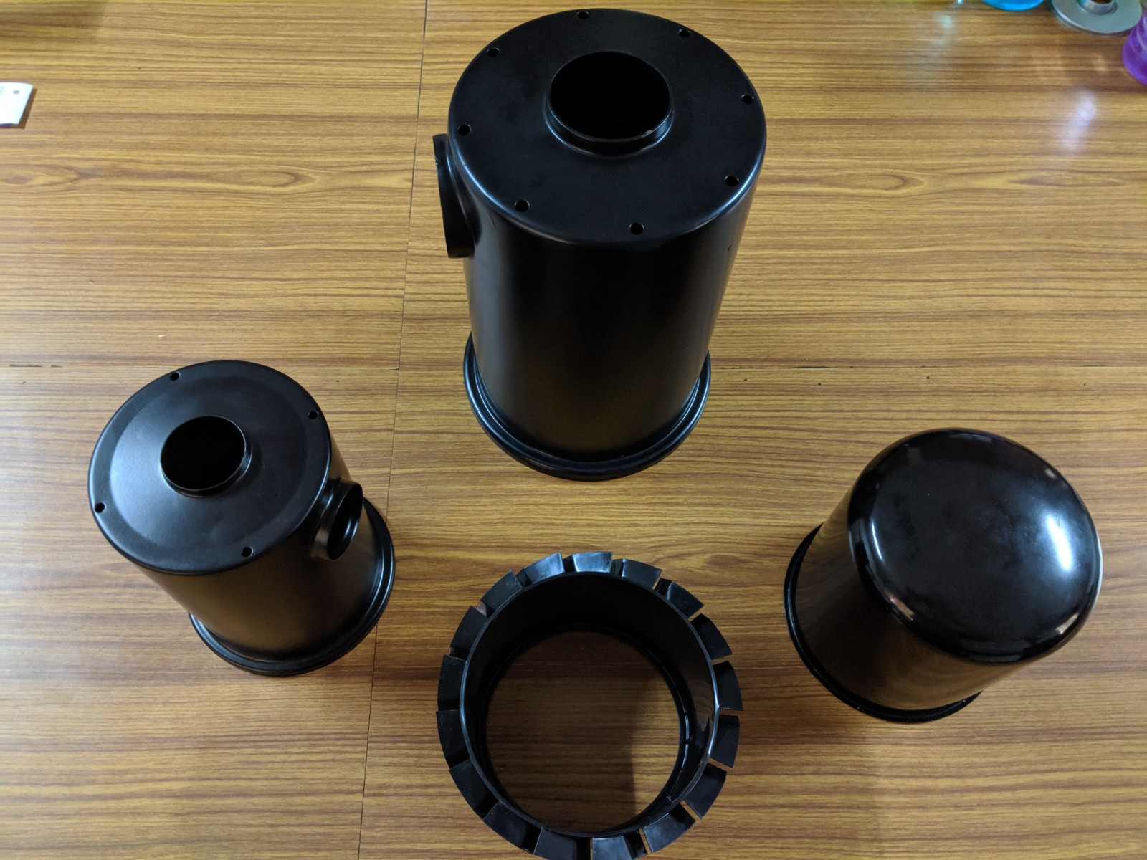
Knorr Bremse: Shell Metal & KB Finn

Slide 33
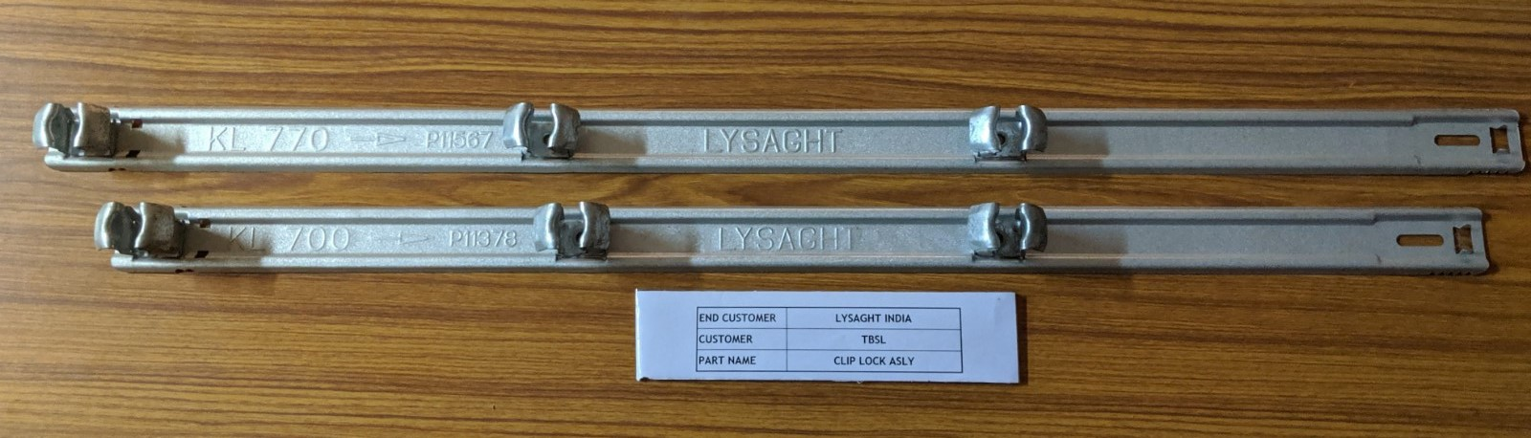
Tata Blue Scope: Clip Lock Assemblies

Slide 34
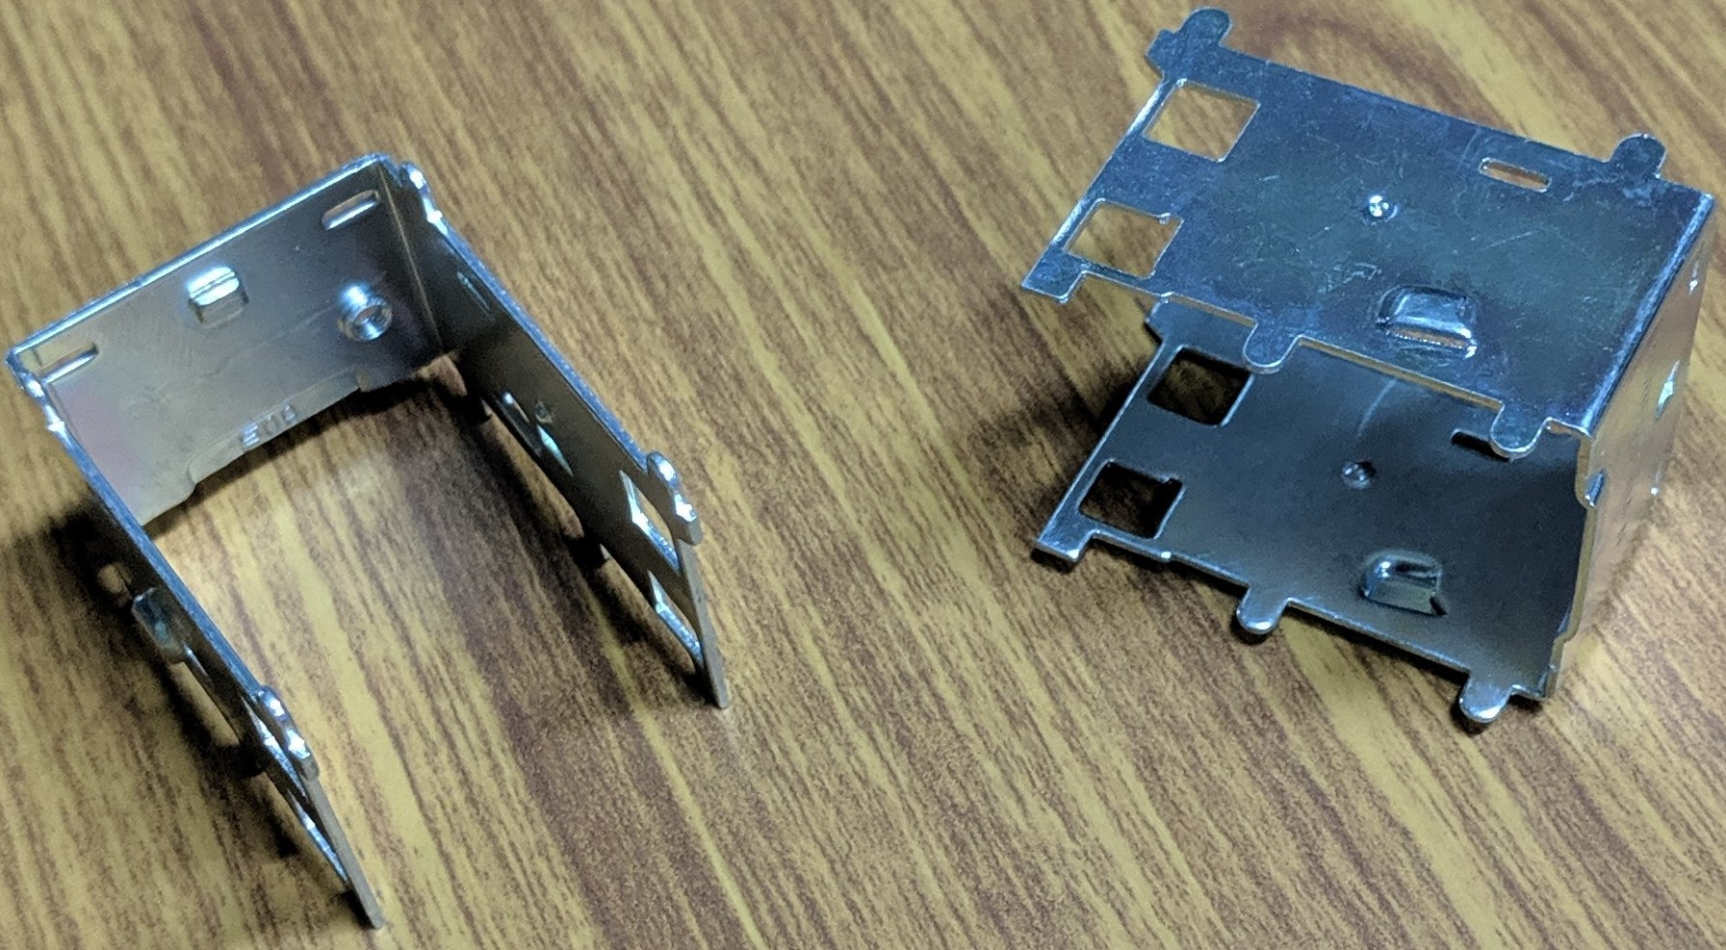
Robertshaw -Thermostat Side Support)

Slide 35





Ultra Engineers : Cap & Bushings for Solar Panel

Slide 36



Air Filter Panel for Clean Room

Slide 37


Awards & Recognition

Slide 38

Ansox : Team Contacts
Sr | Name | Designation | Email | Mobile
1 | Dayasagar Mrig | CEO | dsmrig@me.com | +919823286862
2 | Shashikant Jadhav | Plant Head | Shashikant@ansox.in | +918380047042
3 | Rajesh Argekar | NPD | rajeshargekar@ansox.in | +919850820087
4 | Akshay Shinde | Quality Leader | akshinde@ansox.in | +919923553843
5 | Mahesh Kolte | CAM | sales@ansox.in | +919850097604
6 | Prafulla Patil | Purchase | prafulla@ansox.in | +919922928740
8 | Santosh Bhoite | HR | santosh@ansox.com | +919730211879
9 | Akshay Joshi | IT | Akshay.joshi@ansox.com | +918408888608

Slide 39
Ansox Industries Pvt Ltd
Thank You!!

